Slide 1
Digital Electronics

Slide 2
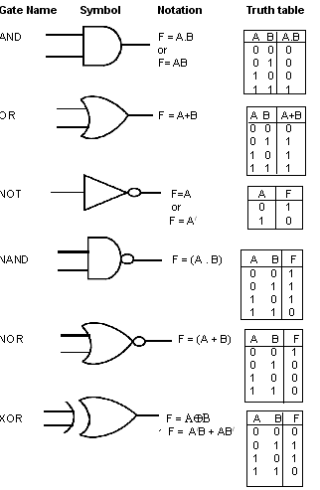

Slide 3
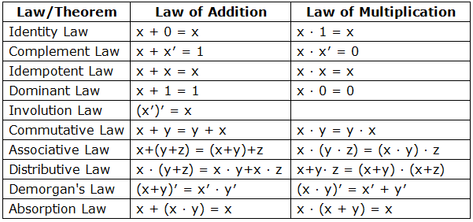
Boolean Algebra

Slide 4
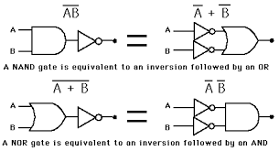
DeMorgan’s Theorem

Slide 5
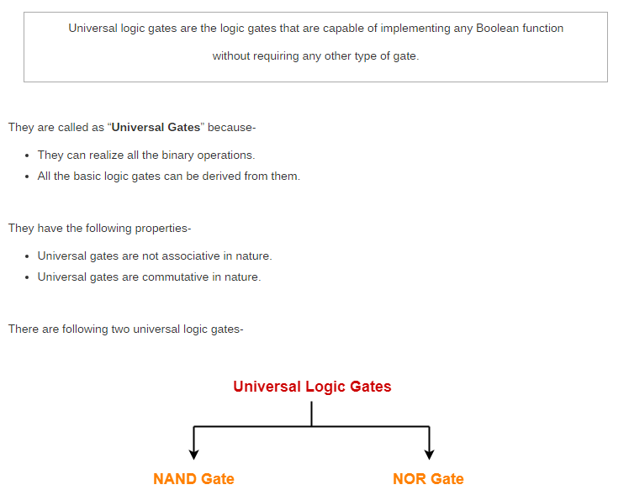

Slide 6
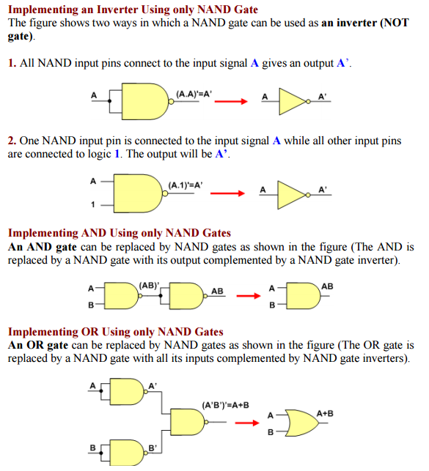

Slide 7

XOR gate using NAND gates

Slide 8
